Slide 1


CHATGPT IN
EDUCATION
An ideal virtual tutor
Student name: Đỗ Minh Duy
Student ID: ITITSB22029

Slide 2
PREVIEW
1. The History of ChatGPT
2. Impacts of ChatGPT
3. Adaptation to ChatGPT

Slide 3
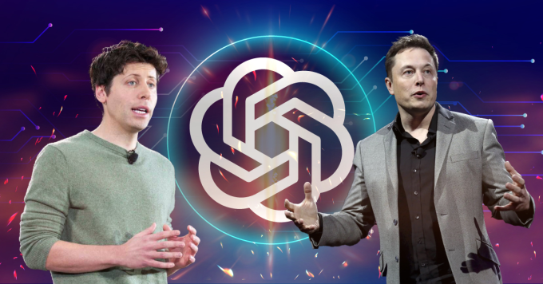
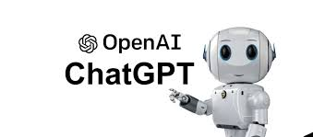
1. THE HISTORY OF CHATGPT
ChatGPT was launched on November 30, 2022

Slide 4
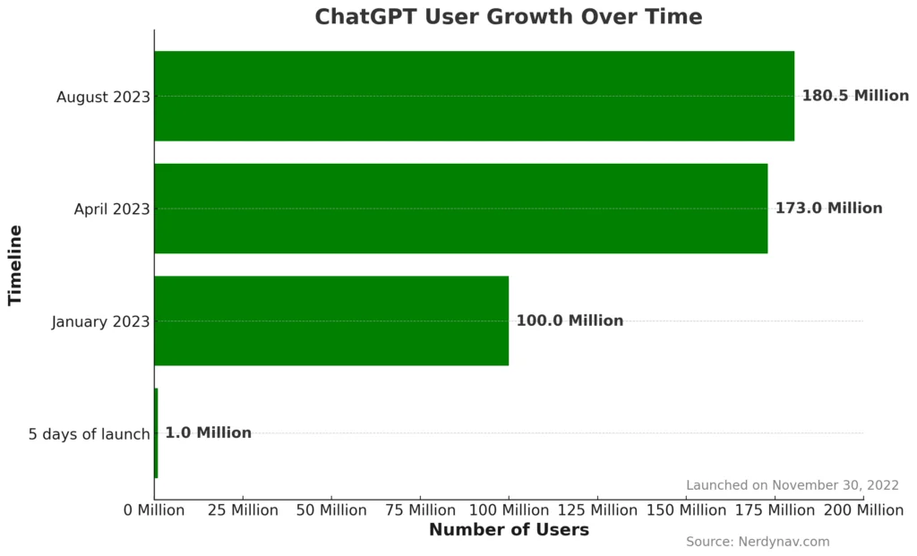


Slide 5
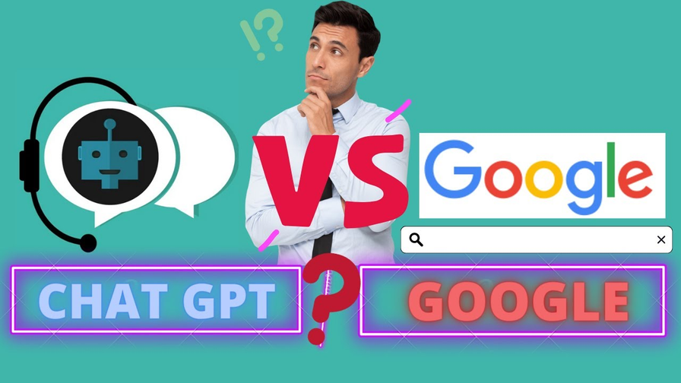
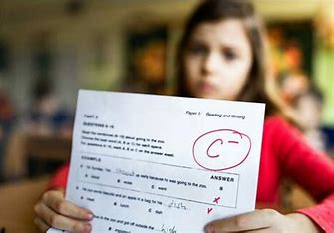
2. IMPACTS OF CHATGPT
POSITIVE SIDES
NEGATIVE SIDES

Slide 6
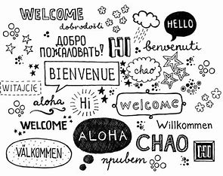

2. IMPACTS OF CHATGPT
POSITIVE SIDES
NEGATIVE SIDES

Slide 7
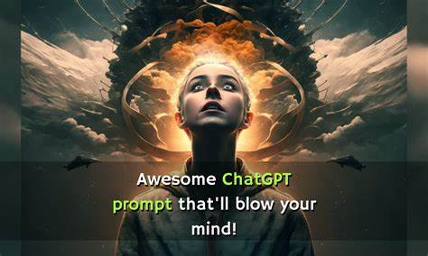
3. ADAPTATION TO CHATGPT

Slide 8
REVIEW
1. The History of ChatGPT
- ChatGPT was launched on November 30, 2022
2. Impacts of ChatGPT
- Improved Language Skills
- Easy Access to Information
- Excessive Reliance on Technology
- Inaccurate Information
- AI and Human Creativity
3. Adaptation to ChatGPT

Slide 9
REFERENCES
1. https://www.pcguide.com/apps/who-created-chat-gpt/
2. https://www.videogamer.com/tech/ai/who-created-chatgpt/
3. https://vnexpress.net/ong-chu-chatgpt-dua-vui-ve-ai-cua-elon-musk-4675416.html
4. https://www.cam.ac.uk/stories/ChatGPT-and-education
5. https://www.nature.com/articles/s41598-023-42227-6
6. https://explodingtopics.com/blog/chatgpt-users

Slide 10
Q&A

Slide 11
THANK YOU

